Slide 1
Fantasy Premier League Chatbot
FPL Chatbot Performing Functions
팀원: 루즈한
AI활용 코드개발 담당, UI담당, 자료조사 및 테스트 담당, 문서작성 및 정리 담당

Slide 2
챗봇 소개
왜 개발하게 되었는지
Fan Engagement: Many football fans are passionate about FPL. A chatbot can enhance their experience by providing quick, accessible information about player stats, tips, and updates.
24/7 Availability: Unlike traditional resources, the chatbot is available anytime, allowing users to get instant answers to their queries without waiting.
Personalized Experience: The chatbot can provide tailored advice based on users' questions, helping them make informed decisions for their FPL teams.
Education: New players often seek guidance on how to play FPL. The chatbot can help educate them about strategies, rules, and features.
어떤 기능을 개발하였는지
Natural Language Processing (NLP):
The chatbot uses Ollama Llama3.1, a sophisticated AI model that understands and generates human-like text. This allows it to interpret user queries and respond naturally, as if chatting with a friend.
Chat History Management:
We maintain a record of the conversation history (chat_history). This enables the chatbot to remember previous interactions and provide context-aware responses, making conversations smoother.
User Interaction:
The chatbot will engage users through a simple web interface where they can type questions about FPL and receive timely responses.
Dynamic Responses:
It can analyze user queries about player stats, team selection, transfers, and other FPL-related topics, responding with relevant information or suggestions.

Slide 3
페르소나 예시
The Casual Player
Name: Sam
Age: 30
About Sam: Sam loves watching football but isn't an FPL expert. He plays just to have fun with friends.
Goals:
Enjoys the game and wants to compete a bit without stress.
Seeks simple tips on setting up and managing his team.
Challenges:
Feels lost with all the complex stats and strategies.
Needs clear, easy advice without jargon.
What Sam Needs from the Chatbot:
Simple explanations of FPL rules.
Quick tips and player suggestions that are easy to follow.
예시 이미지(얼굴 또는 캐릭터이미지)

Slide 4
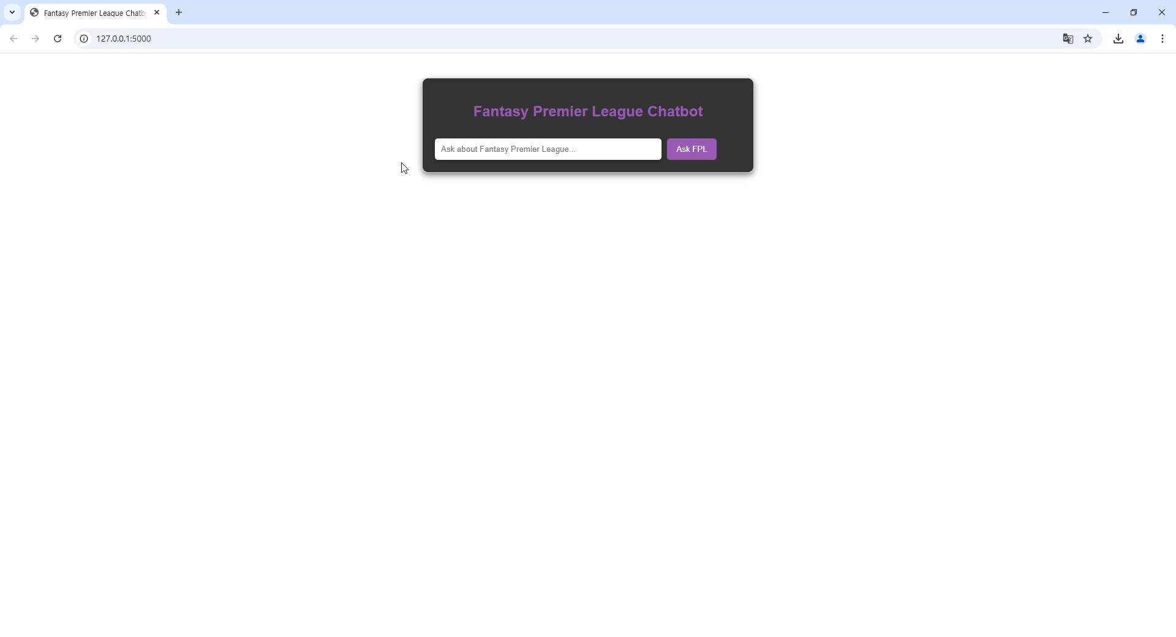
챗봇 시연장면 영상 첨부
Window+G 키 입력시 화면 캡쳐기능을 활용할 수 있음

